Slide 1
Identifying neighbourhood characteristics based upon density of restaurants in Greater Toronto Area (GTA)

Slide 2
Toronto is one of the most multicultural cities in the world
According to the most recent census (2016) the city’s population is made up of 51 per cent of residents born outside of Canada, and this doesn’t even take into consideration the presence of second generation immigrants. Toronto is believed to be home to 230 different nationalities.
Within Toronto over 180 languages and dialects are spoken and according to the 2006 consensus, about 47% of immigrants still practice their mother tongue.
As is common in any large city the immigrant populations have tendencies to reside in neighbourhoods which provide proximity to residents of a similar cultural background. As a result, each Toronto neighbourhood embodies a distinct culture.
Toronto features dozens of recognizable international neighborhoods including Chinatown, Greektown, Roncesvalles Village (Little Poland), Little Italy, Koriatown and Little India.

Slide 3
Toronto is one of the most multicultural cities in the world
The city has sprawled far beyond its official boundaries in recent decades. When speaking of Toronto, we really need to include adjoining communities such as Mississauga, Brampton, Vaughan, Richmond Hill, and Markham, because the city now includes these communities, with residents working and living in any of these communities.
This collective group of Toronto and is neighboring communities is often referred to as the Greater Toronto Area (GTA).
Historically, when immigrant populations settled in Toronto over the past century they tended to settle in the downtown core. Due to crowding in Toronto proper, and increasing real estate prices, communities began to pop up in the west, north and east, and later generations moved to these newer areas of Toronto and surrounding communities.
The result of this relocation of second and third generation immigrants, as well as more recent immigration patterns, is that individual ethnic communities may now have more than one distinct population grouping within the GTA.

Slide 4
Purpose of Analysis
By studying the locations of services catering to specific cultural populations, in particular types of restaurants, we may determine that distinct clusters of restaurants exist throughout the GTA. The locations and clusters of restaurants serving specific ethnic food gives us insight into who might be living in these neighbourhoods.
For example, this clustering may indicate that Toronto does not only have the historic “Chinatown” district in the downtown core – but does in fact have multiple additional “Chinatowns” throughout the GTA. This same clustering of services may indicate the existence of various population groups possessing multiple pockets.
The purpose of this analysis is to provide an understanding of the composition of the neighbourhoods in Toronto, in order to give urban planners, business owners, and even municipal leaders valuable insight into the successful planning and delivery of future services.

Slide 5
Data Collection
All postal codes within the official municipal boundaries of Toronto begin with the letter ‘M’. The web page https://en.wikipedia.org/wiki/List_of_postal_codes_of_Canada:_M will provide the raw neighbourhood data we require for the City of Toronto portion of our analysis.
Since we have expanded our geographic area for analysis to also include Mississauga, Brampton, Vaughan, Richmond Hill, and Markham we need to determine the postal codes of these communities also. This was achieved by manually adding the appropriate additional postal codes.
The latitude and longitude for each Toronto postal code was downloaded from http://cocl.us/Geospatial_data
Venue data will be obtained by making API calls to the Foursquare URL.

Slide 6
Neighbourhoods in GTA
The city of Toronto was divided into 103 unique neighbourhoods
An additional 47 neighbourhoods outside of Toronto were added

Slide 7
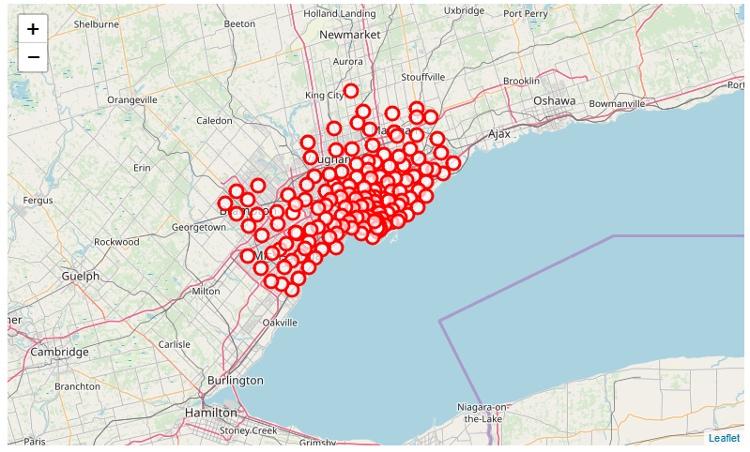
Neighbourhoods in GTA

Slide 8
Neighbourhoods Containing a Density of Chinese Restaurants
Only 19 of the 150 neighbourhoods contained at least 25 Chinese Restaurants.

Slide 9
Neighbourhoods Containing a Density of Chinese Restaurants
Neighborhood | Restaurant Count
Queen's Park | 100
Adelaide, King, Richmond | 100
Ryerson, Garden District | 100
First Canadian Place, Underground city | 100
Chinatown, Grange Park, Kensington Market | 100
Harbord, University of Toronto | 100
Central Bay Street | 100
Design Exchange, Toronto Dominion Centre | 96
Commerce Court, Victoria Hotel | 92
Church and Wellesley | 71
St. James Town | 67
Agincourt North, L'Amoreaux East, Milliken, Steeles East | 61
Stn A PO Boxes 25 The Esplanade | 45
Berczy Park | 41
Harbourfront East, Toronto Islands, Union Station | 39
Richmond Hill Southeast | 39
Agincourt | 38
Markham Northeast | 34
Cabbagetown, St. James Town | 27

Slide 10
Restaurants within Identified Neighbourhoods
1943 Chinese Restaurants exist within the GTA
In the 19 identified neighbourhoods 305 unique restaurants were identified by Foursquare

Slide 11
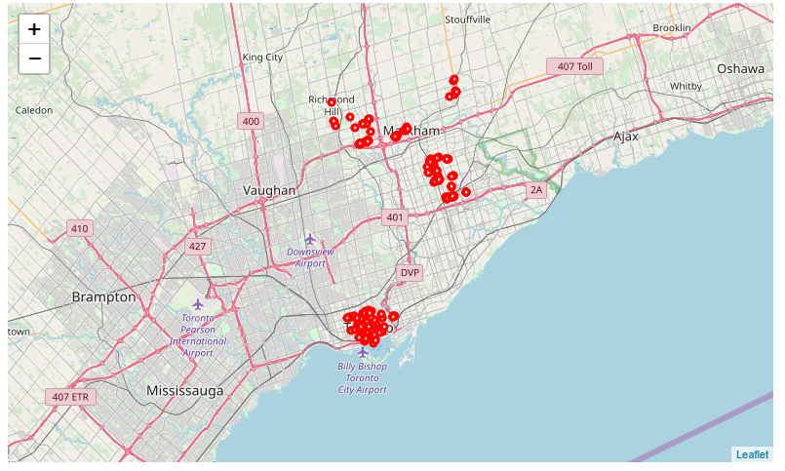
Restaurants within Identified Neighbourhoods

Slide 12
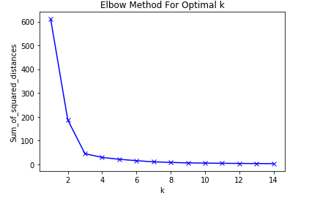
Determine Optimal Number of Clusters
Based upon the Elbow Plot it was determined that the neighbourhoods should be clustered into 3 groupings

Slide 13
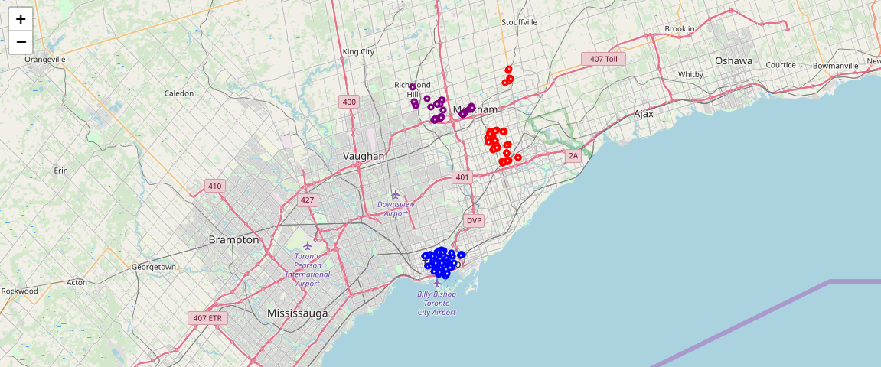
Distinct “Chinatowns” in GTA

Slide 14
Future Refinements
In order to fine-tune the results, we would probably want to further analyze the choices made in the assumptions. In particular:
Assumption 1:
A restaurant is considered to be included in a neighbourhood if it’s geographic location (latitude and longitude) is within a defined threshold of the center of the neighbourhood. Generally speaking the physical size of neighbourhoods within the city of Toronto are smaller than the size of neighbourhoods north of the city. This is a result of higher population densities within Toronto. In order to best accommodate these size differences, the threshold for inclusion in the neighbourhood has been defined as 1750 meters for Toronto and 2500 meters for north of the city.
The distances to be considered (1750 meters for Toronto and 2500 meters for north of the city) may not be the ideal values. This is particularly true north of the city where due to lower populations density the geographic size of the neighbourhoods is significantly larger than inside the Toronto borders.

Slide 15
Future Refinements
Assumption 2:
The minimum density of a restaurant type (Chinese, Italian, Korean, etc.) has been chosen as 25. If a neighbourhood does not contain at least 25 restaurants of the type, then the neighbourhood will be excluded
The density of 25 restaurants may not be the optimal value.

Slide 16
Future Refinements
Assumption 3:
The additional communities of Mississauga, Brampton, Vaughan, Richmond Hill, and Markham have been included in the analysis
Perhaps additional communities should be considered

Slide 17
Conclusions
The analysis of the density of restaurant types within neighbourhoods does appear to provide insight into understanding the composition of the neighbourhoods in Toronto. This determination would provide urban planners, business owners, and even municipal leaders valuable insight into the successful planning and delivery of future services to these communities.

